Slide 1
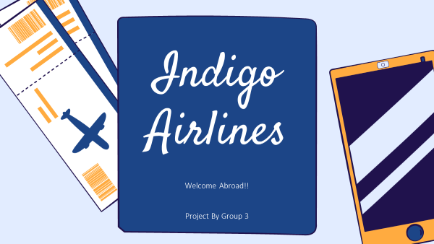

Slide 2
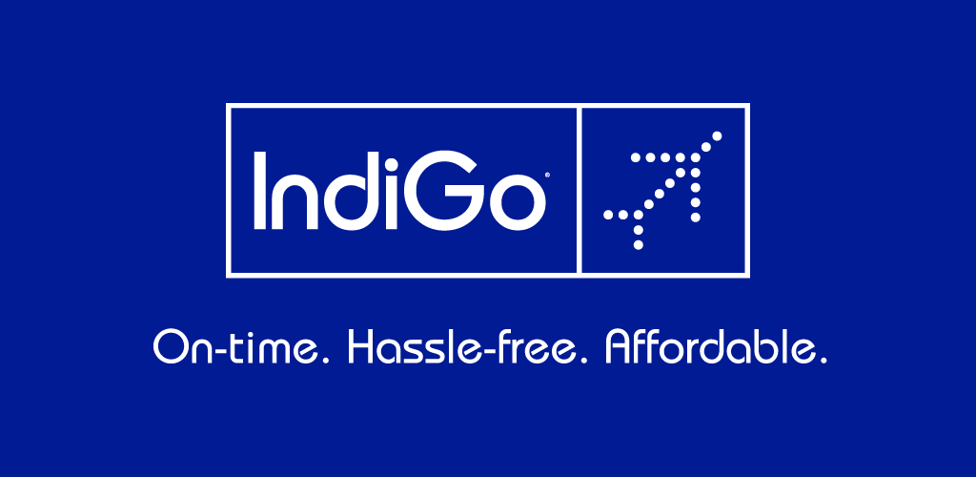
CONTENTS
Introduction History/Timeline Product Lifecycle Product Management Price Management Promotion SWOT Analysis Case Study Competitions Suggestion & Recommendations Summary

Slide 3
GROUP MEMBERS
INDEX
Sr No. | Title | By: Name of Student
1. | Introduction | YASHITA R
2. | History/Timeline | SHREEYA S
3. | Product Lifecycle | SHRADDHA E
4. | Product Management | SEJAL J
5. | Price Management | SANIKA B
6. | Promotion | UTKARSHA P
7. | SWOT Analysis | DISHA V
8. | Case Study | TUSHAR S
9. | Competitions | YASID S
10. | Suggestion & Recommendations | YASID S
11. | Summary | YASHITA R

Slide 4
INTRODUCTION
IndiGo is a low-cost Indian airline based in Gurgaon, Haryana, India.
IndiGo has three unique mottos which is to be on time affordable fares courteous, hassle free.

Slide 5
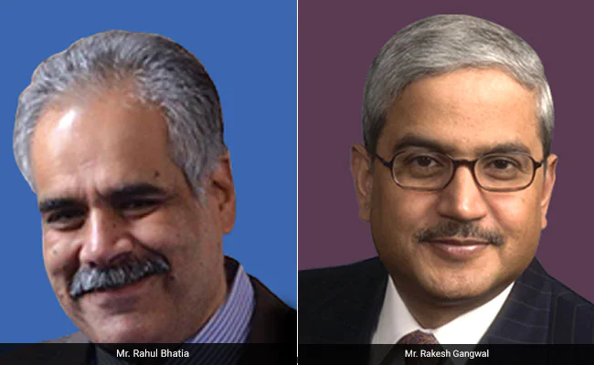

Slide 6
INTRODUCTION
The unique & interesting story behind the launching & partnership of Indigo.
The incredible partnership and amazing bonding of both the founders maintaining their individuality.

Slide 7
HISTORY & TIMELINE
IndiGo is an Indian low-cost airline set up by Rahul Bhatia of InterGlobe Enterprises and Rakesh Gangwal, a United States-based NRI.
IndiGo is an Indian low-cost airline headquartered in Gurgaon, Haryana, India. It is the largest airline in India by passengers carried and fleet size, with a 59.24% domestic market share as of August 2020.

Slide 8
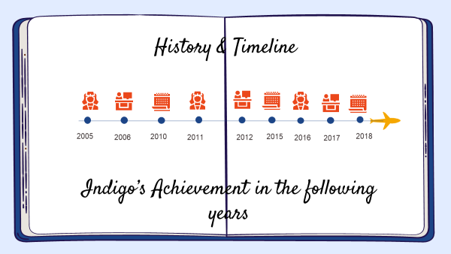

Slide 9

Product Life Cycle
Product life cycle determines its position in the market. Lifecycle management is one of the key tasks of marketing and sales.
The need for effective management of the product life cycle is determined by competitive pressure and ever-increasing demands of customer requirements.
The carrier has captured almost half of the Indian marketplace and shows no symptoms of slowing. however how did IndiGo come to be the dominant player it's miles today?
Following Are The distinctive existence Cycle levels Of Indigo airways. -→

Slide 10
Development
IndiGo is considered one of India’s early low-value airways, founded in 2005 and beginning flying in 2006. however, from early on, IndiGo did things in another way from other airways, opting to area a big plane order before it even released offerings.
In these six years following its first flight, IndiGo hastily grew to grow to be India’s biggest airline.
Efforts that Indigo took helped its to provide its passengers low air fares.
IndiGo is the cutting-edge-day entrant as a low fee issuer in the aviation corporation of India. It started its operations on August 4, 2006.

Slide 11
Introduction
IndiGo came into the market when there were few low-cost airlines and full-service carriers largely dominated. This meant airlines like Jet Airways, Indian Airlines (now a part of Air India), and Kingfisher were market leaders at the time.
IndiGo became one of the quickest developing low value carriers within the world and was the biggest profitable airline in India.
To boom the marketplace share it's far crucial to hold the current patron by means of providing brought values and supplying the identical to new customers as nicely.

Slide 12
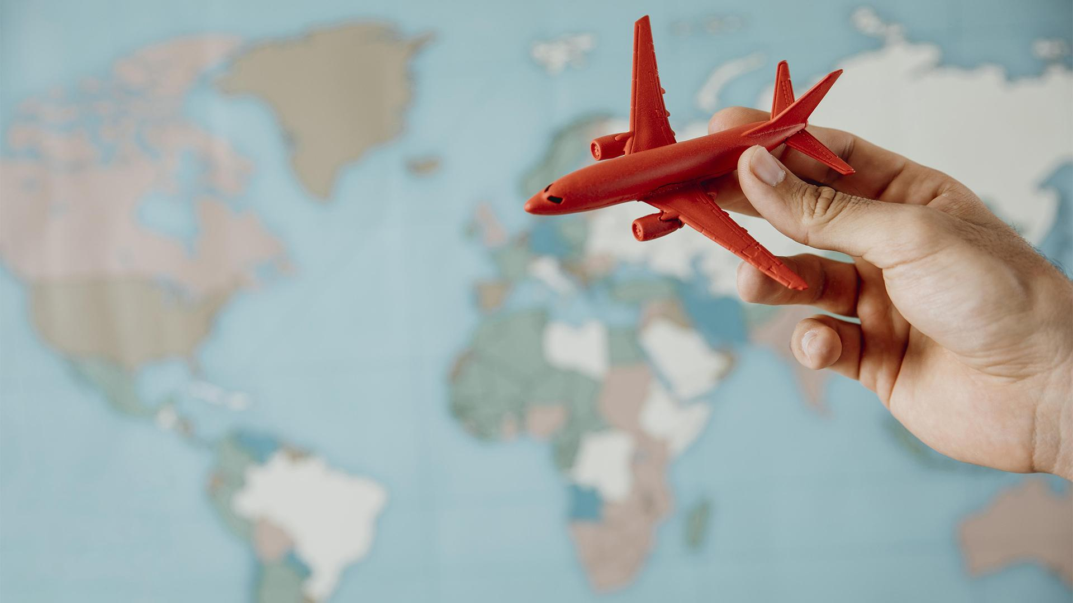
Growth
The product gains popularity, demand and income develop swiftly. Competition increases & charges fall. Economies of scale arise as production and distribution are widened.
Attempt is made to enhance the market percentage via deeper penetration into the prevailing market or access into new markets. The promotional expenditure stays excessive due to increasing opposition and due to the want for effective distribution.
The key competition that indigo airways have confronted over a decade has been from SpiceJet, go Air, Jet airways, Air India and the very currently released Vistara airways. This matrix identifies a firm’s key competition and compares them the use of enterprise’s essential achievement factors.

Slide 13
Maturity The maturity degree is whilst the sales begin to level off from the rapid boom duration. At this point, groups start to lessen their costs which will live aggressive among growing opposition. Indigo airlines have various operations throughout India but nevertheless lacks the worldwide taste. Despite the fact that the high achievement it enjoys on Indian Soil is due to preferred purposeful degree deployment from all domain names. With the help of various strategies, Indigo has so far matured and secured its share and customer relations and attraction.
80%

Slide 14
Decline
Unluckily, in case your product would not grow to be the preferred emblem in a marketplace, you will generally experience a decline. sales will lower at some point of the heightened competition, that's tough to triumph over
Indigo has so far been able to maintain its royalty and top position in terms of the market share and continuously strives to be consistent and focuses on longevity , hence it is very unlikely that Indigo Airlines will shut down and lose its position in market and its priceless shares, it has been a great journey from the very scratch to this height of success and the strategy and services have been satisfactory and commendable , therefore Indigo will most likely continue to grow in the near future, if anything with better marketing strategies & share and more comfort for the passengers.
Hence, they will continue to innovate & improve the efficiency of the airlines.

Slide 15
PRODUCT MANAGEMENT

Slide 16
Product management is an organizational characteristic that guides each step of a product’s lifecycle: from development, to positioning and pricing, with the aid of focusing at the product and its clients first and essential. To build the satisfactory feasible product, product managers recommend for clients in the agency and ensure the voice of the market is heard and heeded.

Slide 17
INTRODUCTION
With a vision to acquire more landscape in the aviation sector, Indigo Airlines has launched the full-fledged charter flight services in the country.
They are the main airline gamers in India.
Under Product Management there are various services provided by indigo airlines for customer attraction, this is also one of their marketing strategies, maintaining good customer relations.

Slide 18
Following are some of the services offered and managed by Indigo Airlines with respect to certain aspects:
Feedback Form: Under the official website of INDIGO-
https://www.goindigo.in/contact-us/feedback.html
Link for feedback
2) Service before Self:
Indigo staff is professionally trained to provide services and to help customers in any situation

Slide 19
3) Services for ticket management: (Booking & Cancellation)
https://www.goindigo.in/plan-your-travel.html
In-app features
More advantageous interface
Quicker checkout
Hassle-free check-in each time, anywhere
Customized experience
upload-on selection

Slide 20
4)Benefits Provided to customers:
There are many benefits provided to the customers
5)Partnership:
Indigo maintains a good reputation with customers but in addition they maintain partnerships.
6)Maintenance:
Maintenance is a very crucial and important part of the process.
Role of Product Manager:
Product manager is a very essential entity.
The product manager has many roles to play.
Indigo provides services to attract the customers and has been maintaining reputation in the market consistently. This is all we could infer about product management

Slide 21
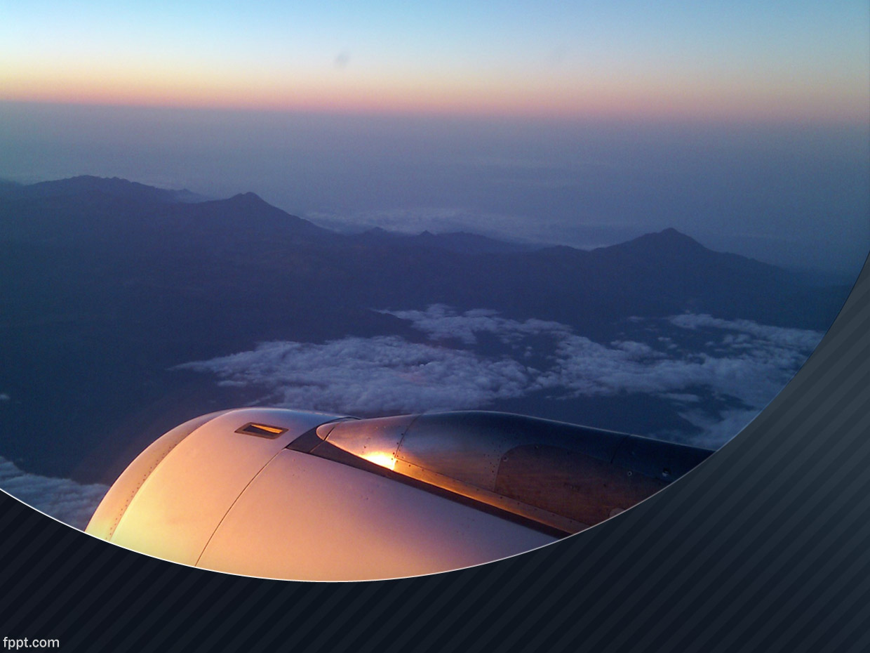
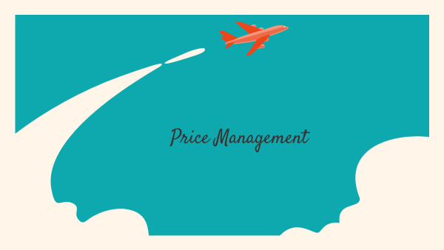

Slide 22
Price Management
Price management is the method of integrating all perspectives and information necessary to always arrive at most useful pricing decisions. Pricing is a fundamental issue of financial modelling and is one of the four P’s.
PRICING STRATEGY OF INDIGO
Cost Base Pricing
Value Base Pricing
Good Value Pricing
Competition Based Pricing

Slide 23
THE AFTER EFFECTS OF THE PANDEMIC:
The airline is presently flying at approximately 32% of its ability and expects that quantity to growth to seventy-five% by early next year.
The coronavirus pandemic has led to a near-overall crumble in air journey call for, forcing airways to reduce charges by using postponing flight routes, laying off group of workers and reducing their fleets.

Slide 24
PLACE | PRICE | DATE
INDORE | 1502 | FEB 2020
PUNE | 2005 | FEB 2020
DELHI | 2240 | FEB 2020
CHANDIGARH | 1980 | FEB 2020

Slide 25
AIR FARE OF INDIGO IN 2021
PLACE | PRICE | DATE
MUMBAI | 6600 | APRIL 2021
DEHLI | 7600 | APRIL 2021
INDORE | 5000 | APRIL 2021
CHANDIGARH | 5600 | APRIL 2021
PUNE | 5800 | APRIL 2021

Slide 26








Slide 27
PROMOTION
Promotion plays a very important part in the sale of the airlines.
Some of their strategies included television commercials, online advertisement and some broad way campaigns. Indigo Airlines does a lot of promotions through billboards/hoardings. The aim of the promotions is to increase the user base and also rope in new customers.

Slide 28
PROMOTION
Some of the campaigns like the one on the valentines day made the biggest hit and got the highest sale for the airlines.
Social media did a huge help in promoting the brand. Indigo did a campaign that delighted lovers on valentine's day which was a huge success .

Slide 29

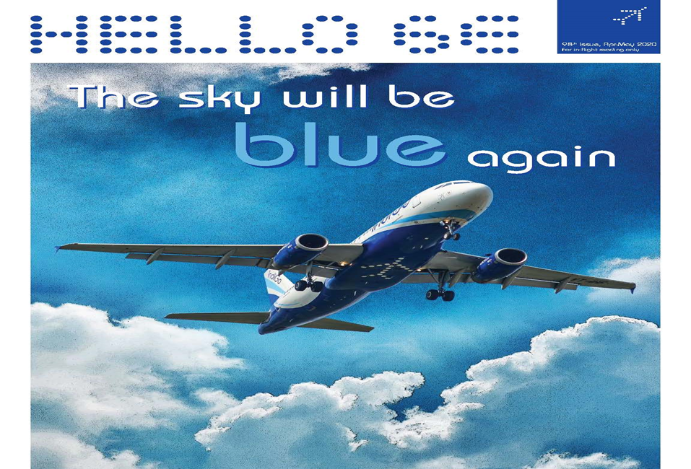
CAMPAIGN
The objective of this campaign was to reach out to young aspiring couples and create a positive word of mouth for IndiGo and cultivate customer loyalty for India’s low cost, no frill and on-time airline that heavily focuses on providing class service to its customers – be it on ground or through social media.

Slide 30
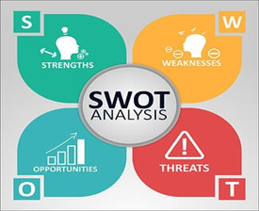
S.W.O.T ANALYSIS

Slide 31
S.W.O.T analysis stands for “ Strength ; Weakness ; Opportunities ; and Threats .
A S.W.O. T analysis is simple yet super powerful tool to help in the development of a business strategy , either it is a start-up or guiding an existing company.
This technique is designed to use the preliminary stages of decision making processes and can be used in evaluation of the strategic position of ones business or any organization.

Slide 32
STRENGTH
Strength is usually defined as what the business does the best and which it can give an upper hand over other companies or its competitors.
These are some of the strengths of INDIGO AIRLINES:-
POSITIVE IMAGE
HIGHLY DRIVE WORKFORCE
FLEET STRATEGY
SERVICES

Slide 33
WEAKNESSES
Weaknesses are used to refer to areas where the business or the brand are lacking and needs improvement .
Some of the key weaknesses of IndiGo Airlines are :
SUSTAINING PROFITS
THE GROUNDING OF AIRCRAFT

Slide 34
OPPORTUNITIES
Opportunities refers to those avenues in the environment that surrounds the business on which it can capitalize to increase its returns .
Some of the opportunities includes :
GROWING DEMAND FOR FOREIGN TRAVEL:

Slide 35
THREATS
Threats are those factors in the environment which can be detrimental to the growth of the business .
Some of the threats include :-
COMPETITION
COSTING

Slide 36
CASE STUDY

Slide 37
5 MAJOR REASONS FOR INDIGOS SUCCESS
Low Cost
Profitability
Punctuality
One Type Of Aircraft
Adding New Planes Regularly

Slide 38
LOW COST
Came into the market when there were few low-cost airlines and full-service carriers largely dominated
Adherence to low cost model
Kept operational costs low
Ticket prices were equal o or sometimes, lower than the prices of 3rd A.C. train tickets
Low fares quickly became popular in India
February 2013-Planned to introduce low-cost regional flights by setting up a subsidiary.

Slide 39
PROFITABILITY
Became profitable 2009 onwards
December 2010-Replaced Air India as the third largest airline in India with a passenger market share of 17.3%
February 2012-Was expanding rapidly and making solid profits, only airline in India to do so
Quarter ending March 2012-Most profitable airline in India and became the second largest airline in India in terms of passenger market share, surpassing Kingfisher Airlines
17th August 2012-Became the largest airline in India in terms of market share surpassing Jet Airways, six years after commencing operations

Slide 40
PUNCTUALITY
Heavy emphasis on punctuality
90% of punctuality rate till date, only Indian airline company to do so
December 2019-First Indian airline to operate 1,500 daily flights

Slide 41
ONE TYPE OF AIRCRAFT
June 2005- Placed an order for 100 Airbus A320-200 aircraft
11 January,2011-Placed an order of 180 Airbus A320 aircrafts, consisting of 150 A320 neos and 30 A320 ceos
15th August,2015-Confirmed the order for 250 A320neo aircraft
29th Ocotber,2019-Placed a firm order for 300 A320neo Family aircraft comprising a mix of A320neo, A321neoLR and A321XLR aircraft, taking its total number of A320neo Family aircraft orders to 730

Slide 42
ADDING NEW AIRCRAFTS REGULARLY
Focuses on adding a new plane every six weeks and sometimes even faster
July 2006- Received its first A320 aircraft
2012-Took delivery of its 50th aircraft
4th November,2014-Took delivery of its 100th aircraft
November 2017-Took delivery of its first ATR 72–600
10th October,2019-Received its 100th A320neo aircraft
31st December,2019-The airline has more than 250 aircraft in its fleet

Slide 43
AFTER COVID
Reported a bad set of numbers in the last quarter of FY20
The consolidated loss in the fourth quarter stood at Rs 871 crore and Rs 234 crore for the full FY21
Airline has taken a series of steps to minimize the impact of the current pandemic-related issues
Converted its 10 aircraft into freighters
Over the past 18 months, the airline carrier has been focusing a lot on cargo operations

Slide 44
PROBLEMS FACED DURING COVID PANDEMIC
A large part of its fleet is still not utilized
Facing efficiency issues with A320ceos for the past few years
A320ceos are essentially old-generation aircraft that not only burn more fuel but also require higher maintenance cost
Usually fly planes for 5-6 years before returning them to lessors, but had to extend A320ceo leases because of issues with A320neos
Already facing problems with A320neos in its fleet that are equipped with Pratt & Whitney (PW) engines
Got a reprieve recently from DGCA
Extended the deadline to replace the faulty PW engines in its A320neos by August 31

Slide 45
COMPETITIONS

Slide 46
COMPETITIONS
We can in reality elucidate from the metric organized that IndiGo has a higher CPM score accompanied via Jet airways and the least preferred happens to be go Air.
The effects are subjective to individual notion and could vary of taken from a collective reaction pool. Nevertheless, based at the crucial achievement factors or parameters taken into consideration and respective weights assigned we arrive at a end that IndiGo has achieved better in comparison to its friends..

Slide 47
COMPARISON WITH OTHER AIRLINES
 | Indigo | SpiceJet | Air India | GoFirst
Foundation year | 2006 | 2004 | 1932 | 2005
Type | Public | Public | Government | private
Headquarters | Gurugram | Gurugram | New Delhi | Mumbai
Employees | 23,531 (by 2019) | 11,675 (by 2020) | 9993 (by 2019) | 2400
Leadership | Rono Dutta | Ajay Singh | Ashwani Lohani | Kaushik Khona
Revenue | ₹37,291.51 crore | ₹13,205 crore | ₹26,430.59 crore | ₹4,553 crore
Fleet size | 274 | 118 | 127 | 55
Destinations | 81 | 53 | 102 | 38

Slide 48
SUGGESTIONS & RECOMMENDATIONS

Slide 49
Indigo Airlines has constantly proved their determination to be at the top and to provide the best of the services to the customers and has so far been able to do a great job at this.
However, there are certain things that we as marketing students have analyzed from our research on their brand and following are the suggestions that we feel could prove to be beneficial for their longevity.

Slide 50
Build even more healthier relationships with their customers to improve their customer relations ratings.
With the enhancement in technologies, there can be certain inclusions in terms of artificial intelligence that will help to reduce man power and save time during the manufacturing of aircrafts.
Introduction of an aircraft series that will include business class will also be helpful to the airlines with respect to increasing their market shares.
Expansion of more international routes & flights can help indigo airlines in their global growth and will help them in their global expansion & recognition globally, which will indeed help in increasing their shares.

Slide 51
With the expansion of indigo airlines, there still lacks connectivity from not metropolitan states & cities such as UP Bihar, Bengal, Bangalore, Hyderabad, pune, ETC.
The partnerships that indigo has with certain shopping brands, they can make these partnerships with local or self-working business brands to help the underrecognized brands to come in limelight, this will help highlight the compassion of indigo towards betterment of every individual together.
In this pandemic, indigo has already taken care of all covid-19 guidelines, but they could offer the patients with medical emergencies perks so that they always choose indigo as their preference.
Maintaining the low-cost carrier can get difficult to manage in terms of shares as well, so hopefully indigo should not drastically increase the charges of flights after the normalcy of pandemic.

Slide 52
RECOMENDATIONS

Slide 53
Increasing advertisement in tier 2 cities will attract more economic pricing concerned segment seeking low-cost carrier services.
• Starting the loyalty program like prime membership and star cards.
• Indigo should increase their regional connectivity through udan scheme.
Once the IndiGo successfully adopts the above said approach and planned it out in fruitful methods then it may quantity itself to fright and chartered services as the subsequent goal for further enlargement.
.

Slide 54
SUMMARY
Market Segmentation:
Indigo chose to segment clients by using the psychographic characteristic of fee recognition.
With growing disposable earnings, the centre magnificence or even the lower centre elegance were capability customers for airlines if the expenses will be made affordable for them.

Slide 55
SUMMARY
IndiGo has won the following awards:
Best low-cost carrier by the Airline Passengers Association of India (2007) Best low-cost carrier at the Galileo Express Travel Awards (2008) Best low-cost airline by CNBC Awaaz (2009, 2013) Best LCC Aviation award for excellence by Centre for Asia Pacific Aviation (2015)
.

Slide 56
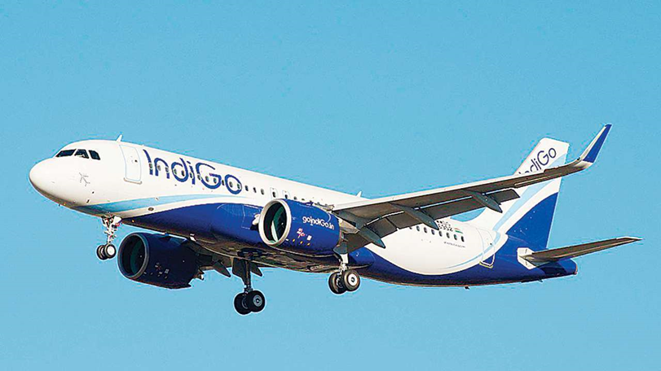
SUMMARY
.
Indigo airlines has done a fairly great job at maintaining its reputation and strives to be at the top in the coming future too.

Slide 57
THANK YOU !! HAVE A GREAT DAY AHEAD.

